Slide 1
Audio-WAV-Synthesizer
Mathematical Sound Synthesis, ADSR Volume Modulation and Raw Binary RIFF/WAVE Serialization from First Principles in C++
TEAM MEMBERS
Shailesh (251150) & Sirthik (251153)
Object-Oriented Programming in C++
Notes:
Good morning everyone. Today we are presenting our project: the Audio-WAV-Synthesizer. Our goal was to create a digital synthesizer in modern C++ that generates audible sound entirely from mathematical first principles, without relying on third-party audio decoding libraries. We will walk you through our object-oriented architecture, audio DSP mathematics, and how we write raw binary WAV files at the byte level.

Slide 2
PROBLEM STATEMENT & SCOPE
Problem Statement & Engineering Goals
First-Principles Algorithmic Sound Synthesis & Raw RIFF/WAVE Binary Serialization in C++17
CORE PROBLEM STATEMENT
"Audio Synthesizer (WAV Generator): Generate audible wave files (sine, square, sawtooth). Requires: Abstract Oscillator and Envelope classes, writing raw binary data using formatted C++ file streams."
CORE TECHNICAL REQUIREMENTS
ARCHITECTURAL DELIVERABLES & DESIGN
Abstract Oscillator Hierarchy: Polymorphic base class defining pure virtual nextSample(), normalized phase accumulation [0.0, 1.0), and concrete derived classes for Sine, Square, and Sawtooth generation.
4-Stage ADSR Envelope Modulation: Piecewise linear amplitude curve (Attack, Decay, Sustain, Release) smoothly modulating audio to eliminate speaker cone clicks and abrupt step transients.
Direct Binary Serialization: Standard 44-byte RIFF/WAVE header assembly and 16-bit signed PCM audio quantization serialized in Little-Endian byte order using unbuffered std::ofstream.
Defensive DSP Boundary Validation: Strict Nyquist-Shannon sampling limit enforcement (freq < rate / 2) to guard against acoustic aliasing, alongside sample clamping [-1.0, 1.0] to prevent integer overflow.
Decoupled Static DSP Engine (synth_core): Headless, reusable synthesis library housing the oscillator hierarchy, configuration structures (SynthSettings), and sample render pipeline.
Scriptable CLI Tool (synth): High-throughput command-line interface parsing parameter flags (--wave, --freq, --adsr, --out) for automated batch rendering pipelines.
Interactive Terminal GUI (synth-tui): Terminal dashboard built with FTXUI, featuring live Unicode Braille oscilloscopic waveform canvas, interactive ADSR graphs, and sliders.
Zero External Codec Principle: 100% self-contained sound synthesis without external audio codecs or proprietary SDKs, achieving cross-platform portability on both x86 and ARM.
Notes:
Here is our core problem statement. Digital sound is just a sequence of discrete numbers. Our challenge was threefold: First, build an extensible class hierarchy to generate standard periodic waveforms like Sine, Square, and Sawtooth. Second, modulate the volume over time using a 4-stage ADSR envelope so sounds don't pop or click. And third, write binary file streams that strictly follow the Microsoft RIFF/WAVE standard so that VLC or Windows Media Player can play our audio without error.

Slide 3
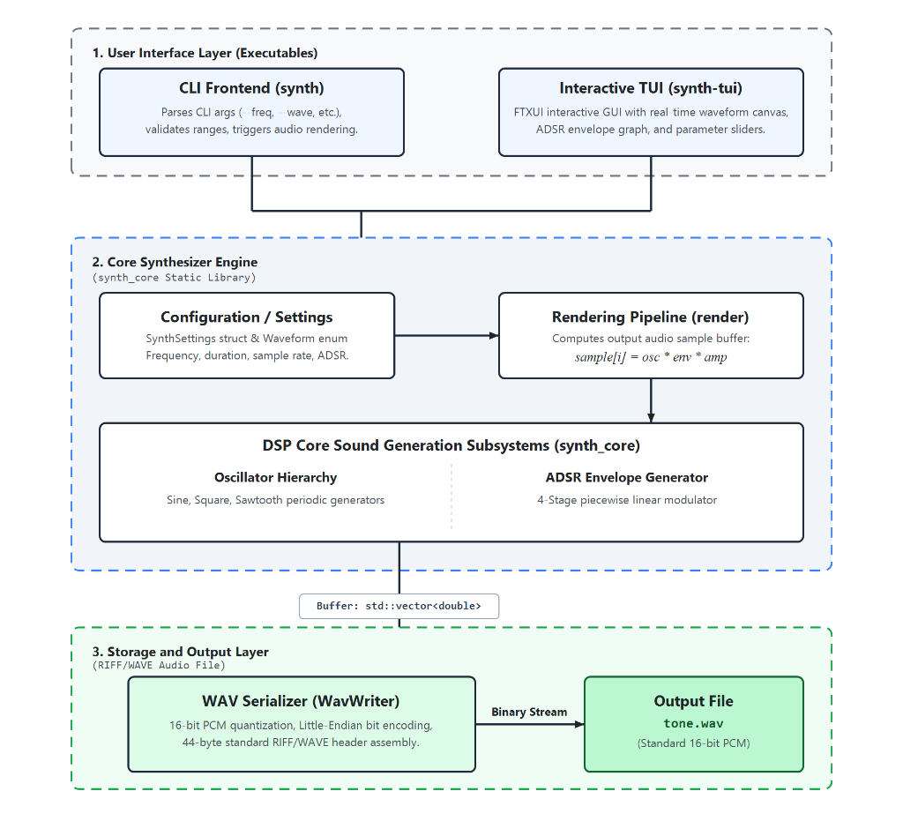
SYSTEM ARCHITECTURE
System Architecture
Strict Separation of Concerns between UI, DSP Engine, and Storage
1. USER INTERFACE LAYER
CLI : Scriptable tool for automated batch generation and command-line pipelines.
Interactive TUI : Terminal GUI with real-time sliders and canvas graphs.
2. DSP CORE (synth_core)
Synthesis engine containing Oscillator base hierarchy, dynamic Envelope shaper, and render pipeline:
sample[i] = osc * env * amp
3. STORAGE & OUTPUT LAYER
WavWriter handles 16-bit PCM quantization, Little-Endian bit shifts, and RIFF 44-byte binary serialization to disk.
Notes:
As shown in our architecture diagram, our system enforces a strict 3-tier separation of concerns. At the top is the User Interface Layer. Both our CLI and our interactive TUI are thin client executables. They contain zero audio generation logic. Instead, they configure a simple SynthSettings data structure and pass it down into our middle tier: the synth_core static library. Inside synth_core, our rendering pipeline queries the oscillator and envelope per sample. The resulting buffer is then serialized into standard WAV audio by WavWriter.

Slide 4
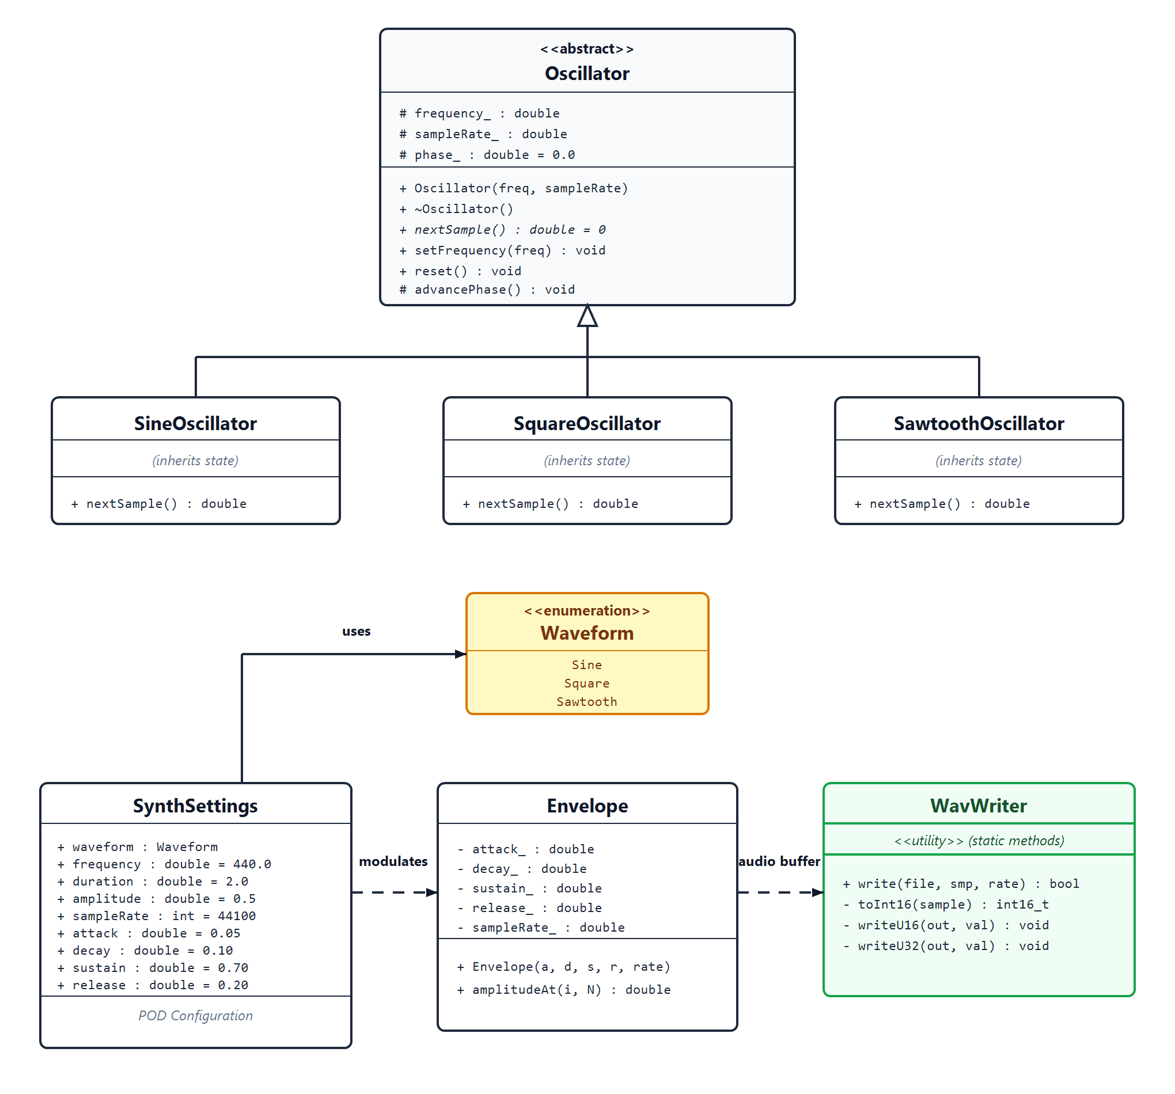
OBJECT-ORIENTED DESIGN
UML Class Hierarchy & Design Patterns
Dynamic Polymorphism & Abstract Class Hierarchy
ABSTRACT BASE: Oscillator
Protected State: frequency_, sampleRate_, phase_.
Pure Virtual: virtual double nextSample() = 0;
Encapsulated Engine: advancePhase() with wrap-around.
DYNAMIC POLYMORPHISM
SineOscillator, SquareOscillator, and SawtoothOscillator inherit from Oscillator and override nextSample() with their specific mathematical models.
Notes:
Looking at our UML class diagram, the heart of our audio generation is the Oscillator abstract base class. It encapsulates protected state: the frequency, the sample rate, and the internal phase accumulator. It defines a pure virtual function, nextSample(), making Oscillator abstract. Concrete classes SineOscillator, SquareOscillator, and SawtoothOscillator inherit from it and implement their unique mathematical formulas. We employ the Factory Pattern via makeOscillator, which returns a polymorphic std::unique_ptr<Oscillator>. By leveraging modern C++ RAII, memory is freed automatically.

Slide 5
AUDIO DYNAMICS
ADSR Envelope & Volume Shaping
Eliminating Speaker Transients & Simulating Real Instrument Acoustics
WHY AN ENVELOPE IS ESSENTIAL
ADSR ENVELOPE CURVE
If an audio wave starts or stops abruptly at non-zero amplitudes, it creates a harsh, audible pop or click.
ADSR guarantees smooth rise from silence and smooth fade back to zero.
Attack
Decay
Sustain
Release
4-STAGE PIECEWISE LINEAR MODULATION
Attack (A): Ramps from silence to peak 1.0 (gain = t / attack)
Decay (D): Drops from peak to sustain level S (gain = 1 - (1-S)*((t-A)/D))
Sustain (S): Constant volume held for note duration (gain = sustain)
Release (R): Fades smoothly down to silence at note end
Notes:
Why do we need an ADSR envelope? If you turn an audio wave on or off instantly, the speaker cone experiences an abrupt voltage jump. This step discontinuity produces an annoying high-frequency pop or click. The Envelope class implements a piecewise linear modulation curve across Attack, Decay, Sustain, and Release stages. Attack smoothly ramps from 0 to peak, Decay drops to the sustain level, Sustain holds the note, and Release fades smoothly back to zero. This simulates real instruments and eliminates all speaker popping.

Slide 6
LOW-LEVEL FILE I/O
44-Byte RIFF Header & Binary Serialization
Raw PCM Byte Quantization & Little-Endian Bit Shifts
RIFF / WAVE 44-BYTE HEADER LAYOUT
16-BIT QUANTIZATION (toInt16)
Byte Range | Header Field | Code Value
00 - 03 | ChunkID | "RIFF"
04 - 07 | ChunkSize | 36 + dataSize
08 - 11 | Format | "WAVE"
12 - 15 | Subchunk1ID | "fmt "
16 - 19 | Subchunk1Size | 16 (PCM)
20 - 21 | AudioFormat | 1 (Linear PCM)
22 - 23 | NumChannels | 1 (Mono)
24 - 27 | SampleRate | 44,100 Hz
28 - 31 | ByteRate | 88,200 B/s
34 - 35 | BitsPerSample | 16 Bits
Converts continuous double [-1.0, 1.0] to signed 16-bit integer [-32768, 32767]:
int16_t toInt16(double sample) {
sample = std::clamp(sample, -1.0, 1.0); // Anti-clipping
return static_cast<int16_t>(std::lround(sample * 32767.0));
}
Guarantees zero integer overflow beyond int16_t bounds.
LITTLE-ENDIAN BYTE PACKING
The WAV specification strictly requires Little-Endian byte order (Least Significant Byte first).
In writeU16 and writeU32, we explicitly extract each byte using bitwise right-shifts (>> 8, >> 16) and & 0xFF masks.
Cross-Platform: Guarantees 100% binary format compliance on both x86 and ARM CPU architectures.
Notes:
Once we have our floating-point samples, how do we create a valid .wav file? We write a 44-byte RIFF/WAVE binary header followed by the audio data. In toInt16(), we clamp our double samples to [-1.0, 1.0] to prevent audio clipping, then multiply by 32,767 to quantize into signed 16-bit integers. Crucially, WAV files require Little-Endian byte ordering. In writeU16 and writeU32, we explicitly extract bytes using bitwise shifts and 0xFF masks, guaranteeing our WAV files work correctly regardless of the host CPU's endianness.

Slide 7
USER INTERFACE & EVALUATION
CLI vs. Interactive TUI & Live Verification
Automated Batch Scripting and Real-Time Terminal GUI
CLI FRONTEND: Scriptable (synth)
INTERACTIVE TUI: Terminal GUI (synth-tui)
Interactive Sliders: Frequency (20-2000 Hz), Amplitude, Duration, ADSR.
Waveform Toggle: Instantly switch between Sine, Square, Sawtooth.
Braille Canvas Preview: Live Unicode Braille waveform and envelope graph.
Single-click export and instant file generation status confirmation.
# Generate 440 Hz Sine wave (2 seconds)
./synth --wave sine --freq 440 --duration 2.0 --out tone.wav
# Generate 8-bit retro Square wave with ADSR
./synth --wave square --freq 220 --attack 0.05 --release 0.3
KEY ACHIEVEMENTS & PROJECT SUMMARY
Zero External Codecs
Clean OOP Architecture
Binary RIFF Compliance
100% mathematical generation from first principles in C++17.
Polymorphic hierarchy, abstract classes & leak-free Factory Pattern.
Quantized 16-bit PCM streaming with Little-Endian byte packing.
Notes:
Finally, we built two user interfaces. Our CLI executable, synth, is fully scriptable with command-line flags and strict input validation. For live experimentation, our synth-tui application uses FTXUI to render interactive sliders and live Braille canvas graphs directly in the terminal, letting users visualize the waveform and envelope before generating the WAV file. In conclusion, our synthesizer meets every engineering objective: robust OOP design, mathematical accuracy, and byte-level file serialization. Thank you, and we welcome any questions!

